Slide 1
LOGISTIC REGRESSION

Slide 2
Agenda
What is Logistic Regression ?
Application of Logistic Regression
Implementation with R

Slide 3
What is Logistic Regression ?
1

Slide 4
Logistic regression is used to analyze relationships between a dichotomous dependent variable and continue or dichotomous independent variables.
Logistic regression combines the independent variables to estimate the probability that a particular event will occur, i.e. a subject will be a member of one of the groups defined by the dichotomous dependent variable.

Slide 5

With One Predictor
Outcome
We predict the probability of the outcome occurring
b₀ and b₀
Can be thought of in much the same way as multiple regression
Note the normal regression equation forms part of the logistic regression equation

Slide 6
Application of Logistic Regression ?
2

Slide 7
Image Segmentation and Categorization
Geographic Image Processing
Handwriting recognition
Healthcare : Analyzing a group of over million people for myocardial infarction within a period of 10 years is an application area of logistic regression.
Prediction whether a person is depressed or not based on bag of words from the corpus seems to be conveniently solvable using logistic regression and SVM.

Slide 8
Implementation with R
2

Slide 9
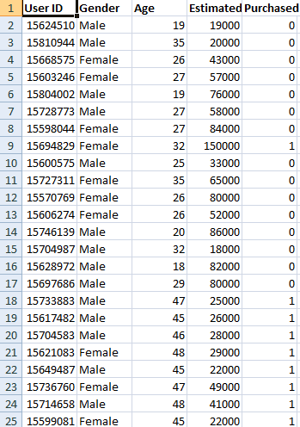
Step 1: Import the Dataset.
Script:-
dataset = read.csv('Social_Network_Ads.csv')

Slide 10
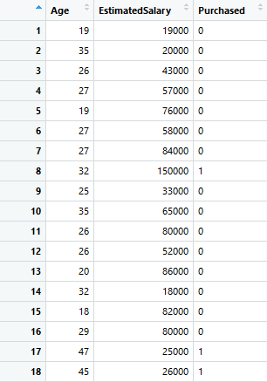
Step 2: Data Preprocessing
Script:-
dataset = dataset[3:5]
dataset$Purchased = factor(dataset$Purchased, levels = c(0, 1))

Slide 11
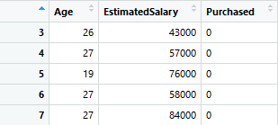
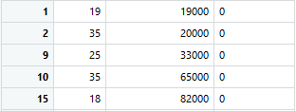
Step 3: Splitting the dataset into the Training set and Test set
Fig. Training Dataset
Script:-
split = sample.split (dataset$Purchased, SplitRatio = 0.75)
training_set = subset(dataset, split == TRUE)
test_set = subset(dataset, split == FALSE)
Fig. Test Dataset

Slide 12
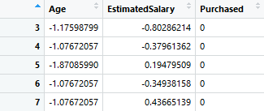
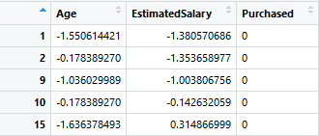
Step 4: Feature Scaling
Fig. Training Dataset
Script:-
training_set[-3] = scale(training_set[-3])
test_set[-3] = scale(test_set[-3])
Fig. Test Dataset

Slide 13
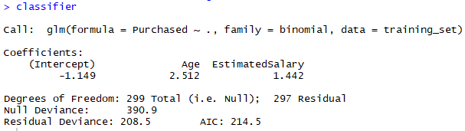
Step 5: Fitting Logistic Regression to the Training set
Script:-
classifier = glm(formula = Purchased ~ ., family = binomial, data = training_set)

Slide 14
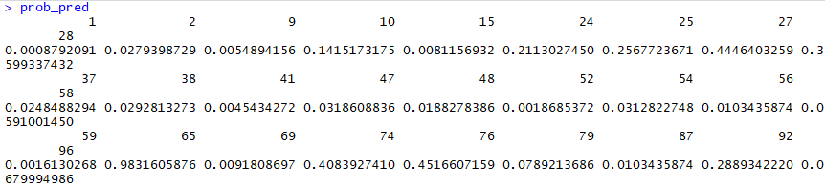
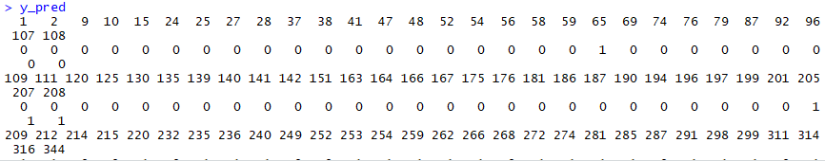
Step 6: Predicting the Test set results
Fig. values of prob_pred
Fig. values of y_pred
Script:-
prob_pred = predict(classifier, type = 'response', newdata = test_set[-3])
y_pred = ifelse(prob_pred > 0.5, 1, 0)

Slide 15

81.0 %
Step 7: Making the Confusion Matrix and Accuracy
Fig. Confusion Matrix
Script:-
cm = table(test_set[, 3], y_pred > 0.5)
accuracy= (cm[1,1]+cm[2,2])/sum(cm)

Slide 16
THANKS!
Any questions?

